Slide 1
Shelf Life Estimation

Slide 2
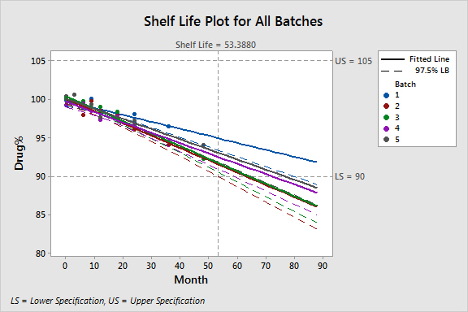

Slide 3
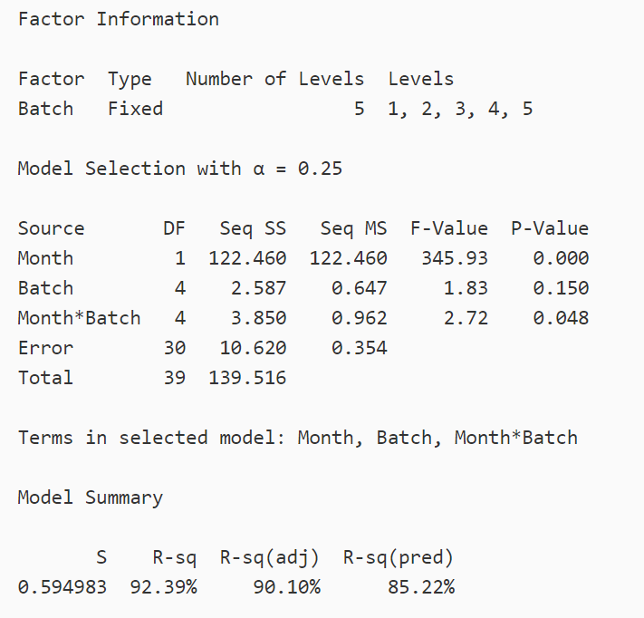

Slide 4
dbg138@psu.edu
https://github.com/dbgriffith01

